Slide 1
AGATA Data Processing
Adapted from D. Bazzacco 2012 EGAN school lecture

Slide 2
Topics
General structure of data acquisition
Data processing model == data analysis model
Narval (ADA/C/C++) and actors ➔ emulators
Data flow ➔ adf
Survey of actors

Slide 3
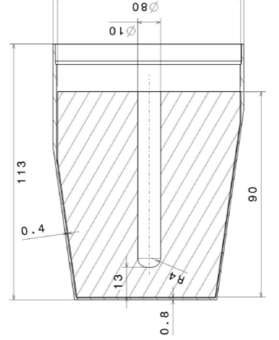
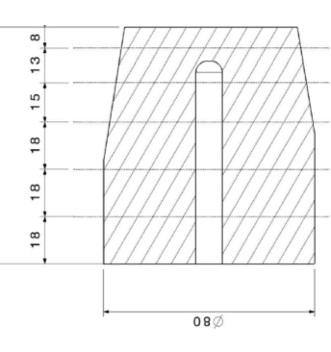
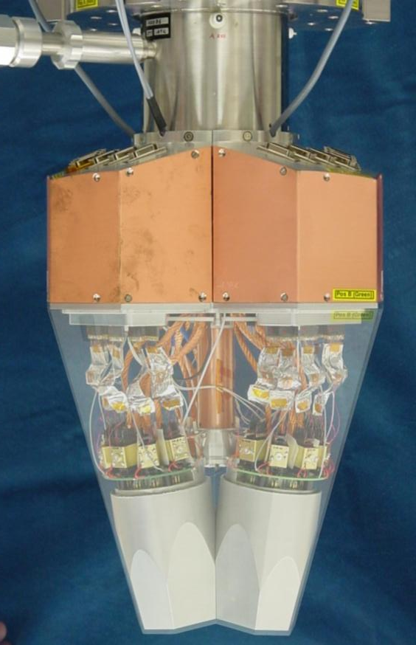
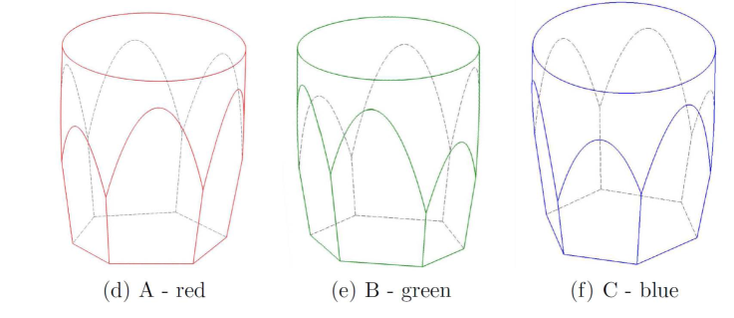
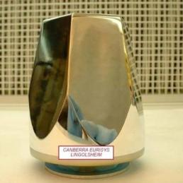
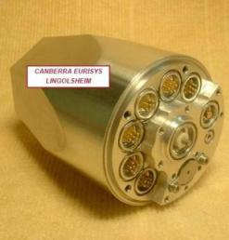
AGATA detectors
80 mm
90 mm
6x6 segmented cathode
Cold FET for all signals
Volume ~370 cc Weight ~2 kg
(shapes are volume-equalized to 1%)
Energy resolution
Core: 2.35 keV
Segments: 2.10 keV
(FWHM @ 1332 keV)
A. Wiens et al. NIM A 618 (2010) 223
D. Lersch et al. NIM A 640(2011) 133
38 high-resolution signals / detector
AGATA Triple/Double Cryostat
Manufactured by CTT

Slide 4
Structure of Electronics and DAQ
Detector
preamp.
GL Trigger
Digitisers
Ancillary
Analogue
Clock
100 MHz
T-Stamp
Up to 180 detectors
PreProcessing
& PSA
Core +
36 seg.
Preprocessing
Electronics
Ancillary
Synchronous
Event Builder
Control,
Storage…
Tracking
Ancillary
Buffered
Other
detectors
interface to GTS via mezzanine
merge time-stamped data into event builder (merger)

Slide 5
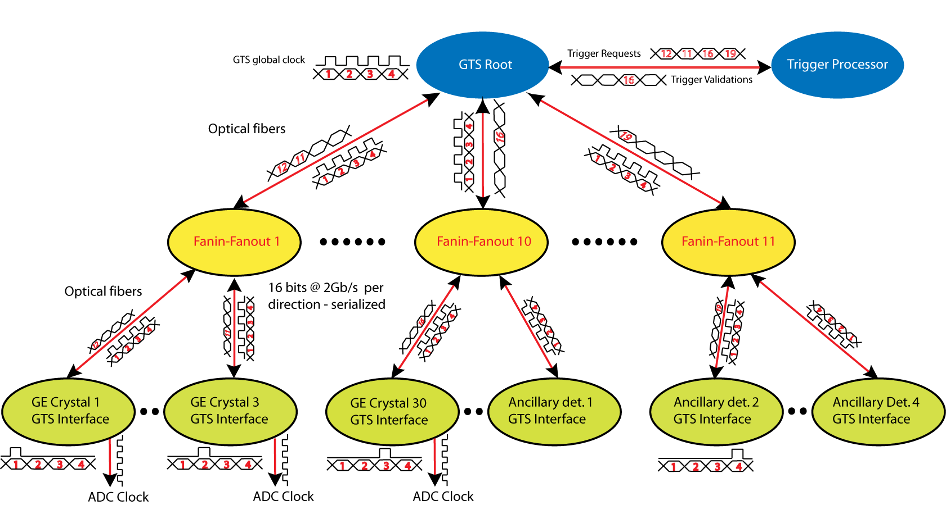
GTS : the system coordinator All detectors operated on the same 100 MHz clock
Downwards 100 MHz clock + 48 bit Timestamp (updated every 16 clock cycles)
Upwards trigger requests, consisting of address (8 bit) and timestamp (16 bit) max request rate 10 MHz total, 1 MHz/detector
Downwards validations/rejections, consisting of request + event number (24 bit)
Up to 256 requesters. Present implementation limited to 40

Slide 6
Architecture of the system
Local Level : where the individual detectors don’t know of each other.
Electronics and computing follow a model with minimum coupling among the individual detectors, which are operated independently as long as possible
Electronics is almost completely digital, operated on the same 100 MHz clock
Data processing (in the electronics and in the front-end computers) is the same for all detectors and proceeds in parallel
Every chunk of produced data is tagged with a 48 bit number (time stamp) giving the absolute time (with a precision of 10 ns) since the last hard-reset of the system ➔ roll around takes place every 32.5 days.
Global Level : where the detectors do know of each other
By means of the real time trigger, which reduces the data rate by selecting the class of interesting events
Via the event builder and merger that assemble the event fragments (including the ancillaries) into complete events that are further processed
In the Tracking and in the Physical analysis stages

Slide 7
00A 00B 00C 01A 01B 01C….
PSA Hits
Digitizer+PreProc
or raw data file (cdat)
VME
VAMOS
N_{dets}
N_{dets}
CrystalProducer
(Save original data)
EventBuilder
Builder.adf
Ancillary Catcher
PreprocessingFilter
EventMerger
Mfm2adf filter
PSAFilter
global actions and
TrackingFilter
Consumer
Vamos.adf
PostPSAFilter
Consumer
Save PSA output (psa.adf)
Consumer
Tracked.adf

Slide 8
Data processing and replay
Offline = Online
A series of programs organized in the style of Narval actors
Director of the actors
Online : Narval
Offline : Narval or narval emulator(s)
Depending on the available computing resources
Single computer or Farm with distributed processing
The system is complex and “difficult” to manage
Very large number of channels NumberOfCrystals*38 1330 Channels➔
No chance to take care of them individually
Rely on automatic procedures
Hope that the system is stable
Result depends on average performance

Slide 9
Use of actors, managed by the framework (Narval or femul)
Creation
process_config and object creation …
process_initialise
Read parameters from confPath/Actor.conf (e.g. Conf/00A/PSAFilter.conf )
Generate configuration-dependent internal objects, open data files
process_start (Important for Producers/Consumers)
process_block (or adf::ProcessBlock) ⬅ the event loop
where the actual work is done
process_stop (Important for Producers/Consumers)
Destruction
Save spectra and close files
A fair amount of repeated code (boilerplate) saved by inheriting from proper base classes (NarvalInterface, NarvalProducer, NarvalFilter, NarvalConsumer provided by the adf library.

Slide 10
Emulator(s)
femul
Originally intended to help developing and debugging the user libraries which is very hard to do in a distributed processing environment like Narval.
Gradually developed as a full emulation of the Narval framework with the limitation of being a single process running a specific machine (threads used to distribute the work on the available cores).
Configuration (detectors, actors, ..) specified by a “topology” file
Generation of configuration parameters via gen_conf.py
GammaWare and Watchers
Spy directly the on-line data in the on-line Narval actors
Converting the psa.adf, builder.adf or tracking.adf files

Slide 11
00A 00B 00C 01A 01B 01C….
Digitizer+PreProc
or raw data file
VME
GammaWare inputs
VAMOS
Femul inputs
N_{dets}
N_{dets}
GammaWare Output
CrystalProducer
(Save original data)
EventBuilder
Femul inputs
Ancillary Catcher
Femul output
PreprocessingFilter
EventMerger
Mfm2adf filter
PSAFilter
Femul inputs
global actions and
TrackingFilter
Consumer
Vamos.adf
PostPSAFilter
Femul inputs
Femul inputs
Femul output
Consumer
Psa.adf
Consumer
Tracked.adf
GammaWare inputs
GammaWare inputs
Femul output
GammaWare Output

Slide 12
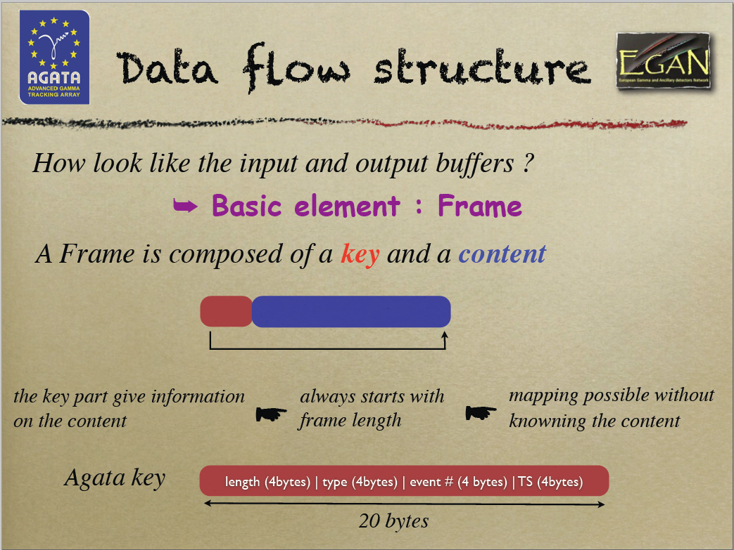
Olivier Stezowski

Slide 13
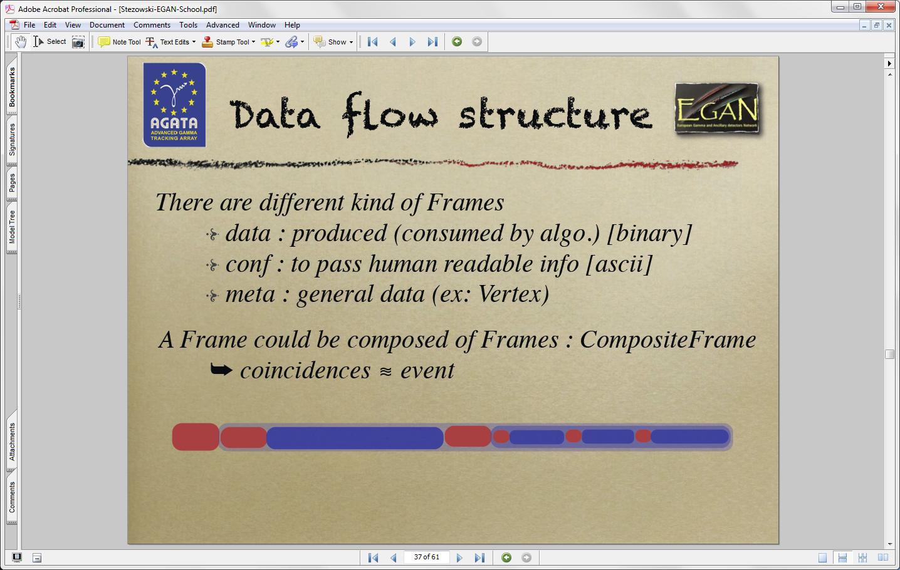
Olivier Stezowski

Slide 14
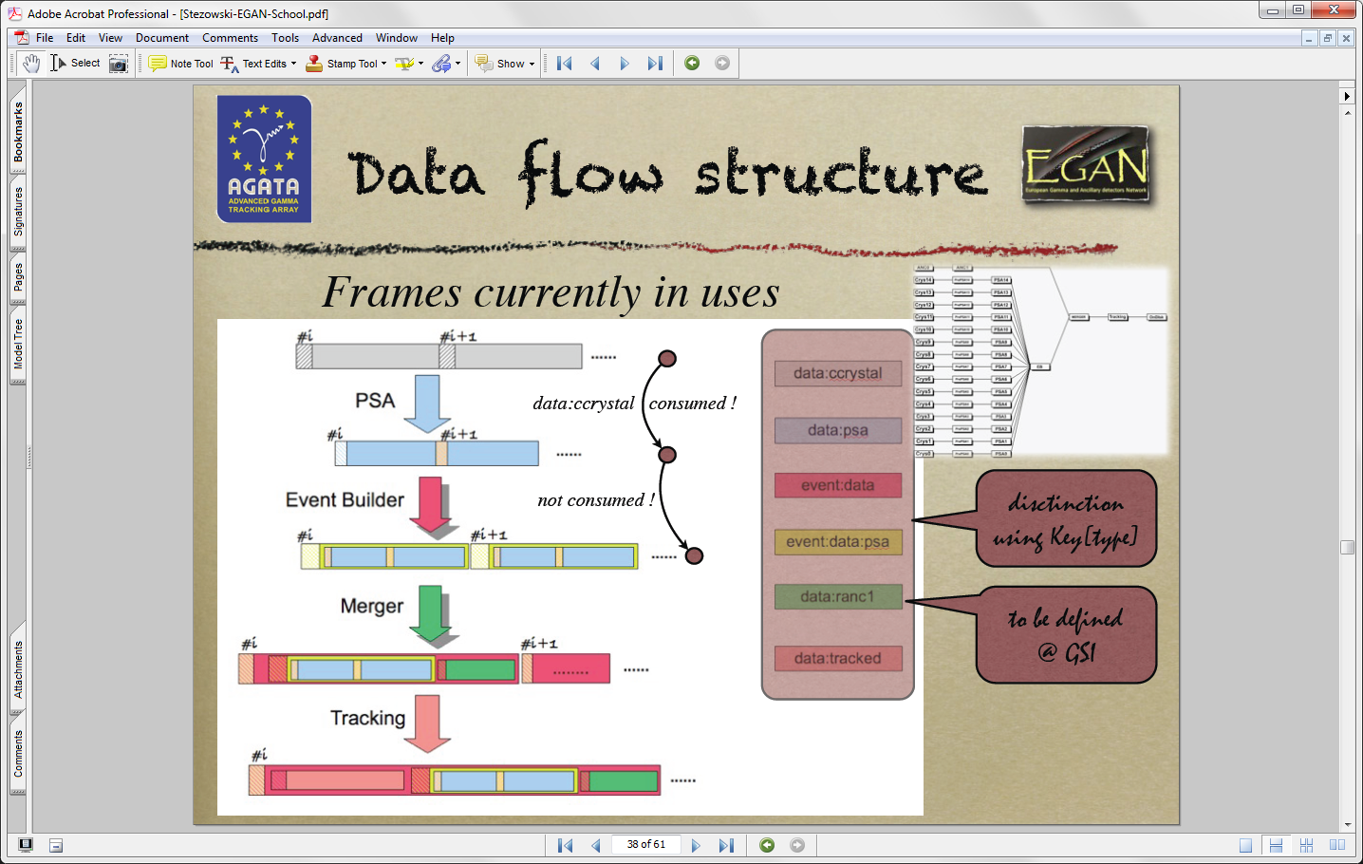
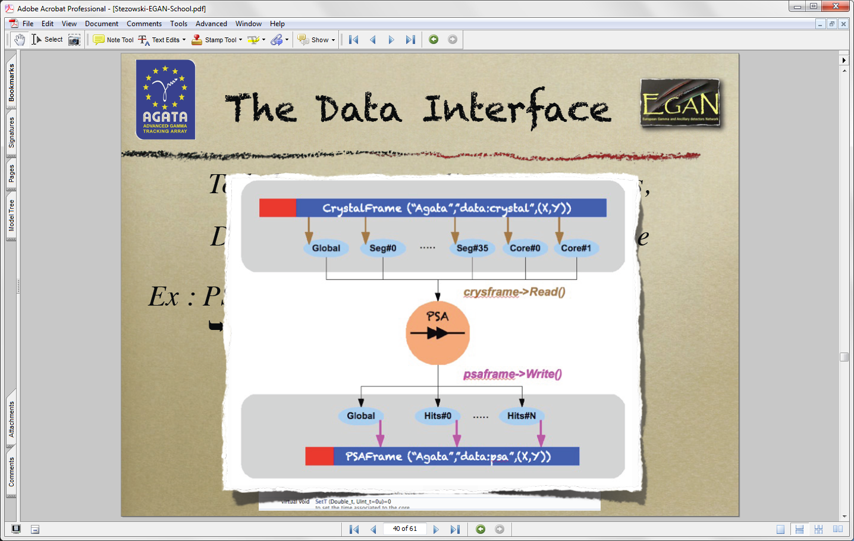
Olivier Stezowski
Olivier Stezowski

Slide 15
Structure of analysis directories
The directory where you produce your data ( e.g. /agatadisks/exptname (EXXX) /(Config EXXX)/run_XXX_date) contain some standard sub-directories
Conf → configuration of actors, calibrations, ... for each detector
00A, 00B, 00C ... 14B, 14C Ancillary(ies) Global
with minimal differences between online and offline
Data → data and spectra produced during the experiment
00A, 00B, 00C ... 14B, 14C Ancillary(ies) Global Online writes data here Offline replay takes data from here
Out → data and spectra produced during data replay
00A, 00B, 00C ... 14B, 14C Ancillary(ies) Global Offline writes data here
Conf, Data and Out are often symbolic links to actual directories

Slide 16
Typical configuration directories
Conf/12A
Conf/Global
CrystalProducer.conf
CrystalProducerATCA.conf
PreprocessingFilter.conf
PreprocessingFilterPSA.conf
PSAFilter.conf
PostPSAFilter.conf
xdir_1325-1340.cal
xinv_1325-1340.cal
BasicAFC.conf
BasicAFP.conf
EventBuilder.conf
EventMerger.conf
TrackingFilter.conf
CrystalPositionLookUpTable
BasicAFC.conf

Slide 17
Binary spectra
Simple C-style multidimensional (max 6) arrays written mostly in binary format
For historical reasons the format is not recorded in the file.
Often written as part of the file name:
Prod__4-38-32768-UI__Ampli.spec Is a file dump of an array defined as unsigned integer Ampli[4][38][32768] containing 4*38 = 152 spectra of 32768 channels
No difference between spectra and matrices; the type is only an hint to how to interpret them
The viewers TkT and Mat can decode and interpret the format. The user can always override the program.
Other programs (e.g. RecalEnergy) can interpret the spectrum length and type but the user has to specify the number of spectra to act upon.

Slide 18
Some Useful programs
TkT spectrum viewer (& al) tailored to composite detectors
A nightmare concerning programming-style, but contains ~all I need(ed) to analyze AGATA data. Virtually no documentation.
RecalEnergy
Analysis of spectra looking for peaks
SortPsaHits
Sort of PSA hits (special format) to determine neutron damage correction parameters
gen_conf.py
Unified procedure to produce configuration files for all actors
solveTT.py
Optimize time alignment of “equal” detectors

Slide 19
Local Actors
Producers
CrystalProducer
Readout of electronics, or get raw data from file
Local event builder
Save original data to be able to replay experiment
Raw projections
Filters
PreprocessingFilter ➔ PreprocessingFilterPSA
Energy calibrations
Retrigger and Time calibration
Cross talk correction
Amplitude calibration and time alignment of traces
Improved pile-up rejection
PSAFilter ➔ PSAFilterGridSearch
Decomposition of calibrated experimental traces by comparison with a calculated signal basis
In principle more than one algorithm available but only one used in practice.
PostPSAFilter
Neutron deficit corrections
Recalibrations of energy and time
Smearing of positions (not recommended)
Consumer
Save PSA hits for “Global Level”-only processing

Slide 20
Global Actors
Event Builder
Essentially a producer with multiple inputs
Assemble event fragments from Ge detectors (Builder) and Auxiliary detectors (Merger)
Filters
TrackingFilter
Global histograms (time, energy …)
Grouping and further filtering
Format data as needed by the specific Tracking Filter
Histograms of tracked gammas
Consumer
Write tracked data

Slide 21
CrystalProducer
Reads the data from:
The PCI express driver connected to the ATCA/GGP electronics
Raw data files (event_mezzdata.cdat) for the offline (
Acts as a local event builder to check and merge the sub-events coming from the ATCA/GGP readout (or from the raw data file)
For the online has to work in nonblocking-mode to avoid blocking the ACQ
This feature was implemented with boost::threads
Damiano has now implemented the “select” and threads have been removed
The local event builder and the management of the mezzanine data should be completely rewritten …
Can write the original data with the format of the ATCA/GGP electronics, and various other formats (e.g. only the energies for calibrations)
Prepares data:crystal frames, without using adf (version using adf exists, maybe slower)
Not much to do for the users both for Data Acquisition and Data Replay

Slide 22
What does it read and write
Raw event: data from 7 mezzanines hosted in two ATCA Carrier Boards or data from the single GGP per anode
length (for 100 samples traces): 16+(8+100)*6 = 664 short (2 bytes) words
Event length: 7*664 = 9296 bytes
Local event builder to assemble data from 2 readout ports, according to mapping specified in CrystalProducerATCA.conf contains the mapping
Write original data (event built, compressed→ 3.6 kB)
data files typically split after 1 M events ~ 3.6 GB
event_mezzdata.cdat.0000 event_mezzdata.cdat.0001 …
Generate raw spectra for amplitudes and baselines
Format data into an data:crystal adf frame and send it to the data flow.

Slide 23
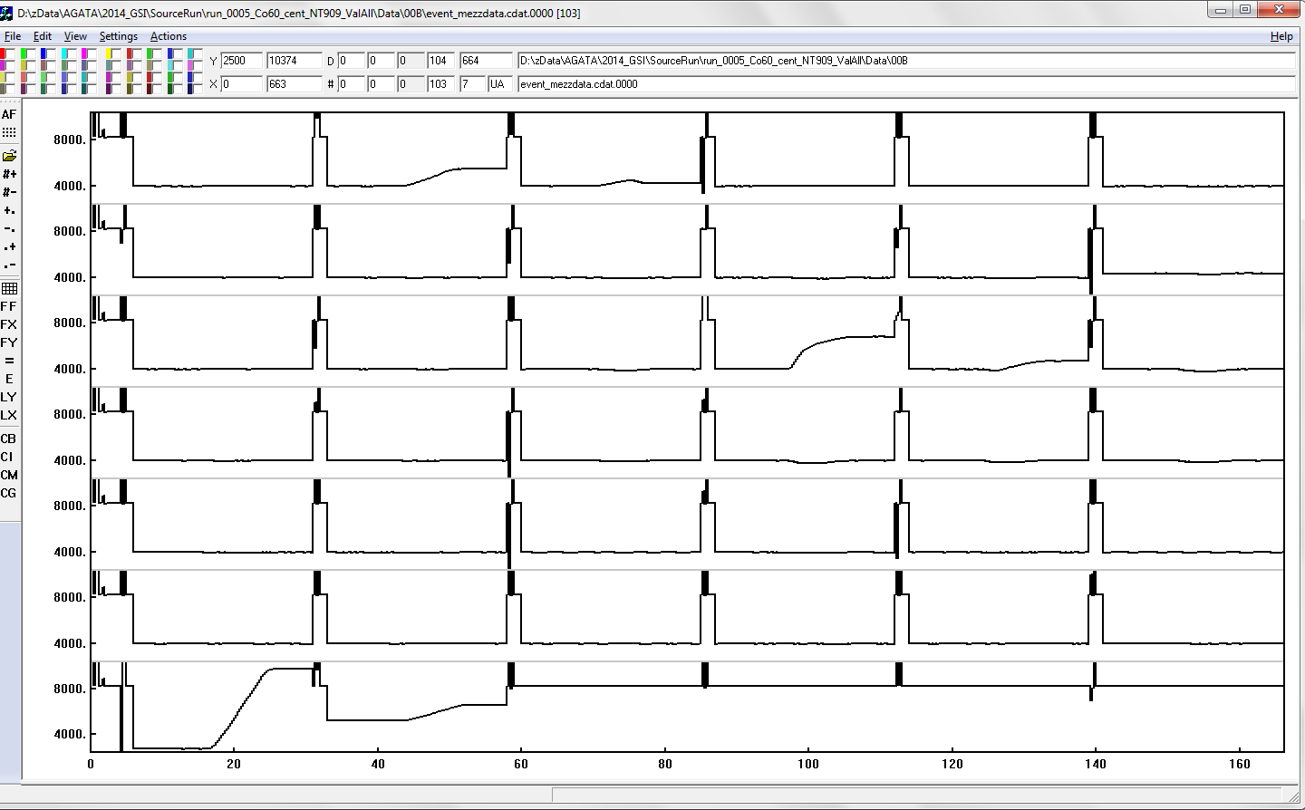
Raw data from EDAQ
F6 F5 F4 F3 F2 F1
E6 E5 E4 E3 E2 E1
D6 D5 D4 D3 D2 D1
C6 C5 C4 C3 C2 C1
B6 B5 B4 B3 B2 B1
A6 A5 A4 A3 A2 A1
CC
High Gain
CC
Low Gain

Slide 24
Digitizers
100 MS/s
max frequency correctly handled is 50 MHz (Nyquist)
14 bits
Effective number of bits is ~12.5 (SNR ~75 db)
2 cores (one board) and 36 segments (in 6/3 boards)
Core 2 ranges 5, 20 MeV nominal
Segments taken either at high gain (5 MeV) or at low gain (20 MeV)

Slide 25
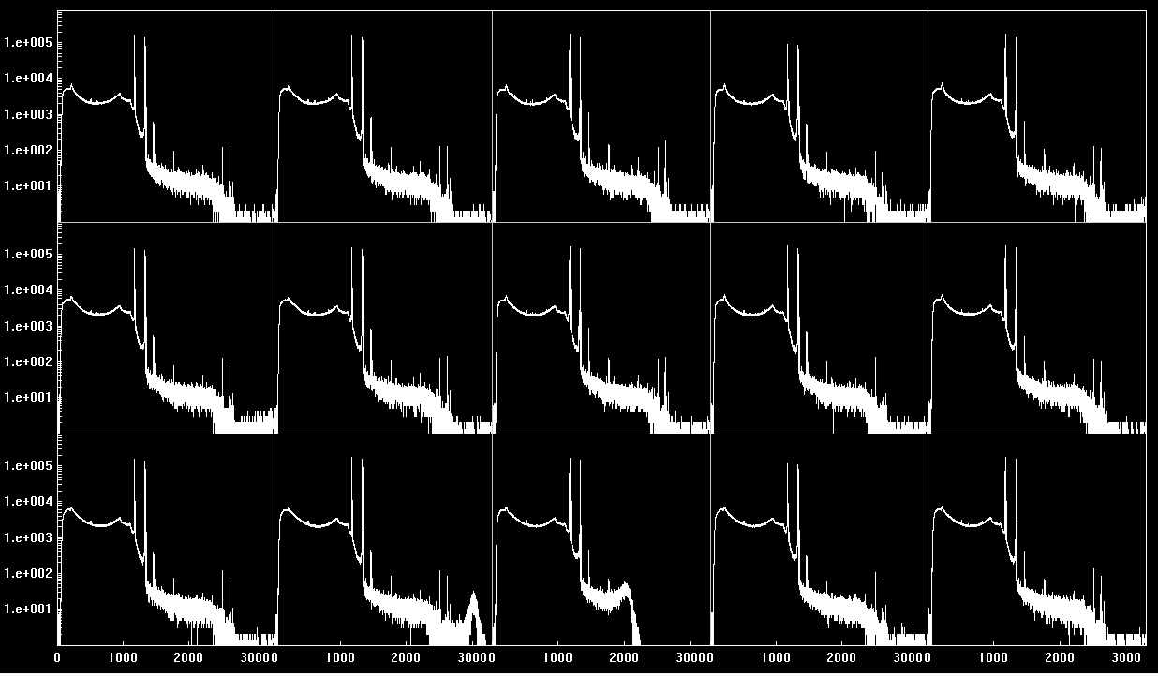
Range of digitizers 1
Some cores and segments saturate below 3 MeV on the high-gain range
Gain in the digitizers should be reduced by ~30% → Low gain for segment to be set in the digitizers

Slide 26
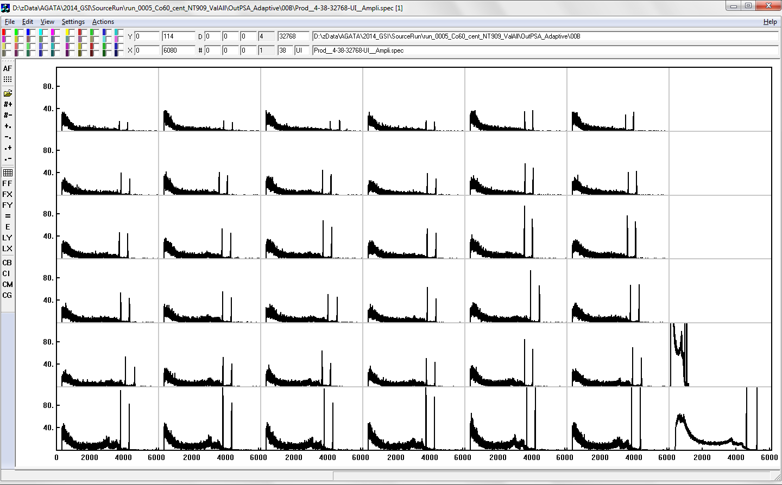
Prod__4-38-32768-UI__Ampli.spec [1]-38-32768 used for energy calibrations
A6 B6 C6 D6 E6 F6
A5 B5 C5 D5 E5 F5
A4 B4 C4 D4 E4 F4
A3 B3 C3 D3 E3 F3
CC1 Low Gain
A2 B2 C2 D2 E2 F2
A1 B1 C1 D1 E1 F1
CC0 High Gain

Slide 27
PreprocessingFilter
Performs
Energy calibrations and cross talk corrections
Analysis of traces
Calculation of T0 from core (Digital CFD or linear fit of the first samples)
Time calibrations and shifts
Vertical normalization of traces
Define the net-charge segments
Reformats the data as data:ccrystal frames
After Preprocessing:
energies are stored in units of keV
times are in units of samples (10 ns) (but time calibration parameters are in ns)
positions are given in mm, when they show up after the PSA

Slide 28
Calibrations
Energy
Gain-only, no offset coefficient needed because of the way the amplitude is generated in the preprocessing electronics.
Challenged by the Differential Non Linearity (DNL) of the ADC
Cross-talk
36*36=1296 coefficients to correct capacitive coupling correlations between segments and core
Used also to recover up to one broken or missing segment per crystal
Time
Local → 36 coefficients to alignment of segment to the core great influence on the performance of PSA
Global → alignment of crystals and other detectors important to reduce random coincidences
Response function of the system
To match the PSA calculated signals to the real data
Neutron damage
Recover energy resolution of the segments using info from PSA.

Slide 29
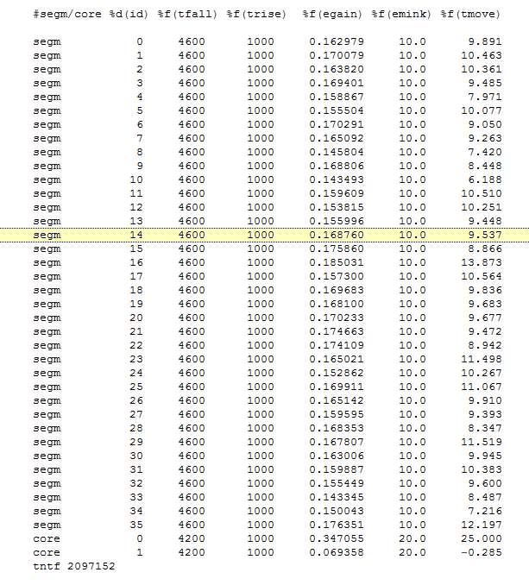
PreprocessingFilterPSA.conf

Slide 30
Cross-Talk
Proportional
Affects energy spectra of multi-segment events
xTalkSort …
Differential
Affects rise-time of signals and therefore PSA
Not yet fully characterized

Slide 31
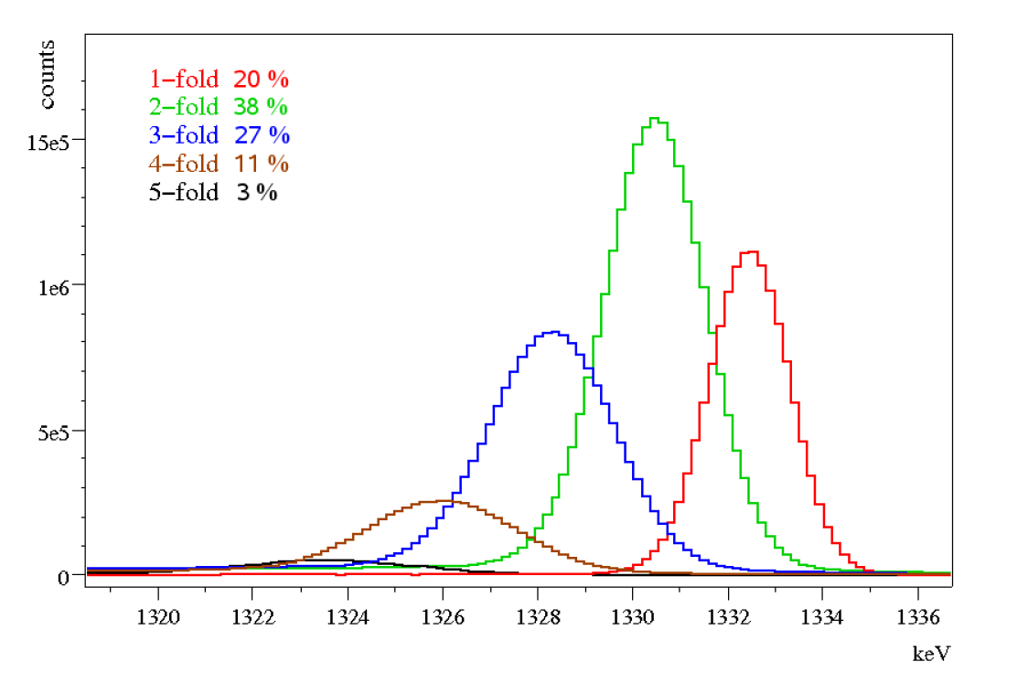
Crosstalk correction: Motivation
Crosstalk is present in any segmented detector
Creates strong energy shifts proportional to fold
Tracking needs segment energies !
Sum of segment Energies vs fold
Energy [keV]
Segment sum energies projected on fold
2folds : Core and Segment sum centroids vs hitpattern
…All possible 2fold combinations
Notes:
For the last part of my talk, I would like to draw the attention to a problem common to any segmented detector : namely cross talk.
This creates strong energy shifts in the segment sum energy, and this proportional to the hit multiplicity:
Doubles are shifted compared to singles. Three folds even more, and so on. >>
If one analyzes the doubles, one observes that it does not simply consists of a single peak, but:
By sorting the two folds into all possible twofold combinations, one observes that the centroids of these peaks are individually shifting according to a regular patten.
The same happens in the core,however there is no such offset observed as is in the segments.
There is thus real physics behind this phenomenon.
>>

Slide 32
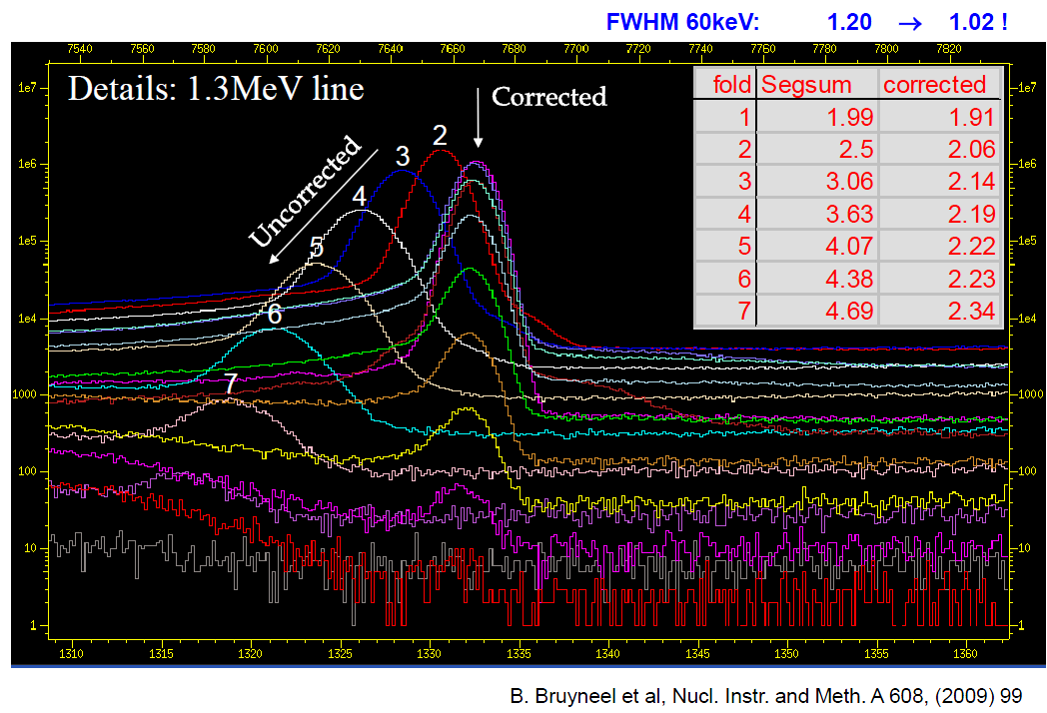
Cross talk correction: Results

Slide 33
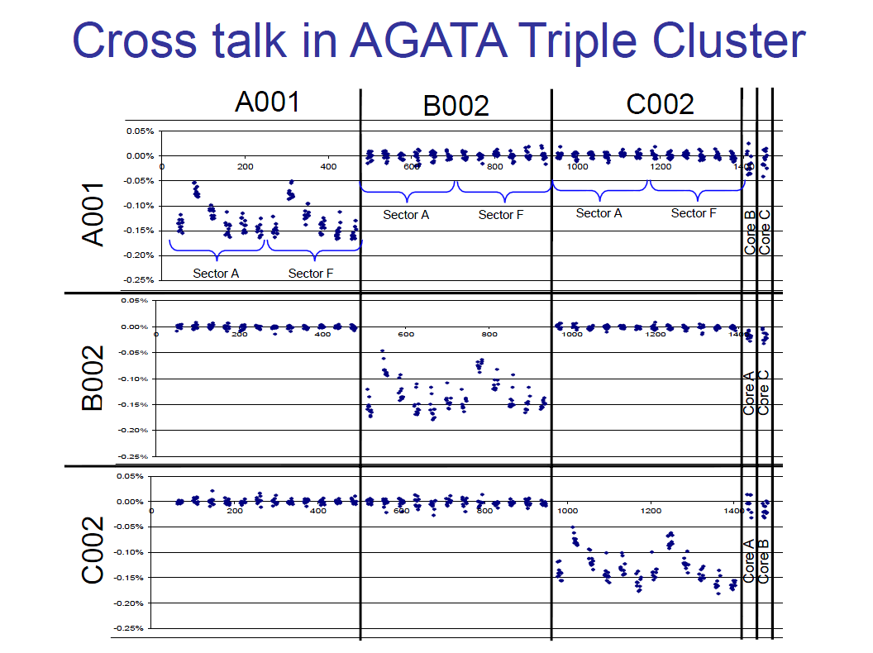
Cross talk

Slide 34
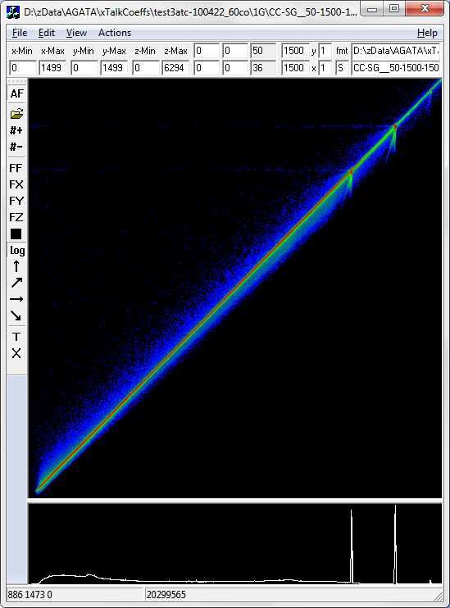
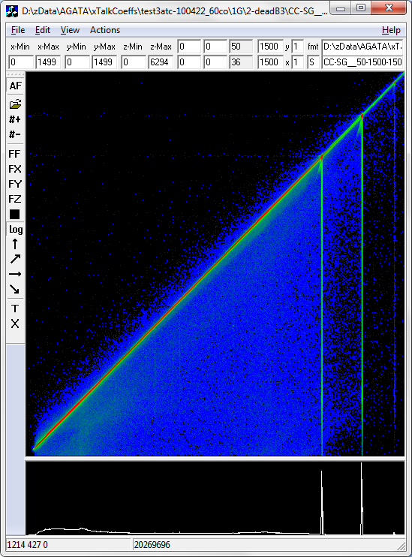
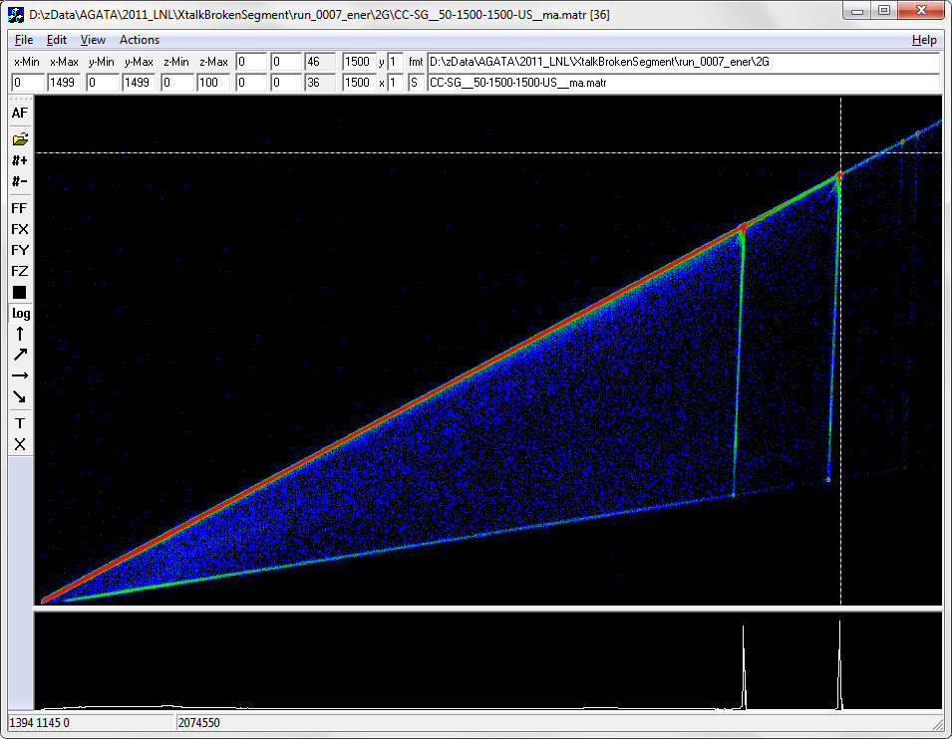
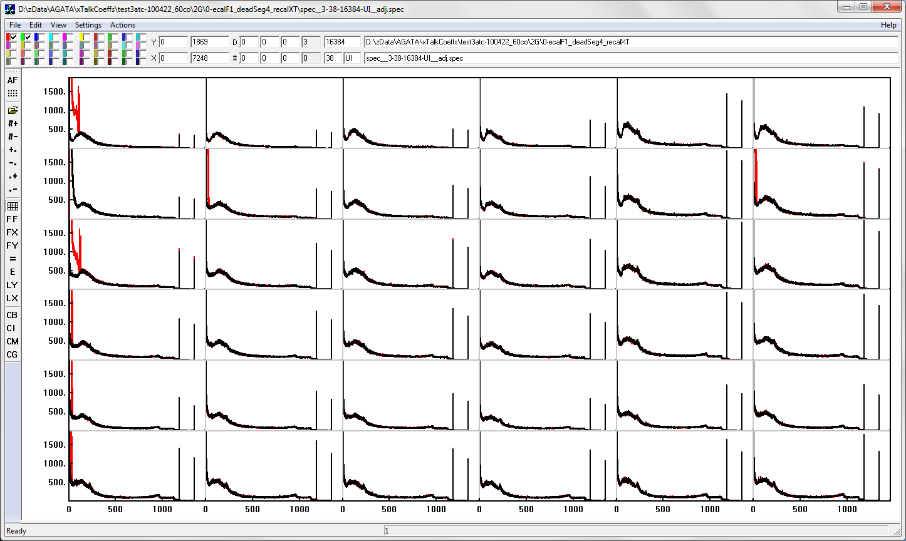
Missing/Broken segments
OK
Missing
Broken FET
1332.5
[1332.5, 1267.5]
SumSegs
[1312.9, 366.2]
Core
Core
Core
1332.5
Read the Cook Book by Rosa Perez
Exploiting the redundancy ∑Segs==Core
Compensate loss of energy in core
Assign energy to missing segment E_{missing} = E_{core} -Sum_{Othe}r
Remove ghost peaks in neighbours and determine energy of missing segment as an extreme case of cross-talk
Final energy of missing segment using again SumSegs==Core
Recovery of broken segment

Slide 35
Time calibrations at Local Level
Need to align the traces because the hardware does not compensate all time lags
Need to re-trigger the event of a whole inside the capture time. Important is the absolute time of the first sample (timestamp)
Straight line fit or Digital CFD of the signal rise-time using info from core and segments.

Slide 36
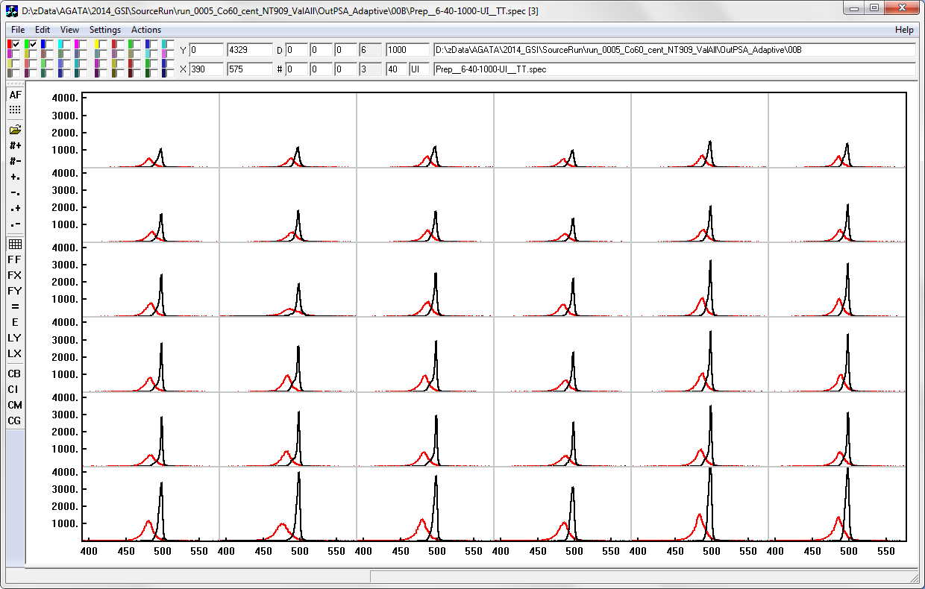
Time alignment of segments re Core

Slide 37
PSAFilter
Signal decomposition
Implemented algorithm is the Grid Search
As a full grid search
As a coarse/fine search (AGS)
Reduces size of data by factor 20
Provides the parameters for the correction of neutron damage (can also perform it)
Must be expanded to improve timing
Takes ~95 % of total CPU time
Is the critical point for the processing speed of online and offline analyses

Slide 38
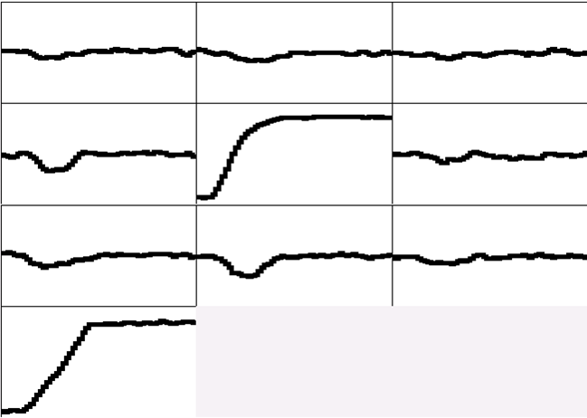
Pulse Shape Analysis concept
A3
A4
A5
B3
B4
B5
C3
C4
C5
CORE
measured
791 keV deposited in segment B4
Courtesy Francesco Recchia

Slide 39
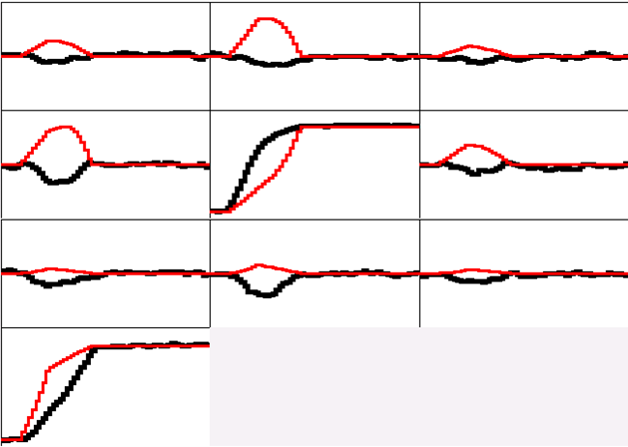
Pulse Shape Analysis concept
A3
A4
A5
B3
B4
B5
(10,10,46)
C3
C4
C5
y
CORE
C4
B4
measured calculated
D4
A4
x
791 keV deposited in segment B4
E4
F4
z = 46 mm

Slide 40
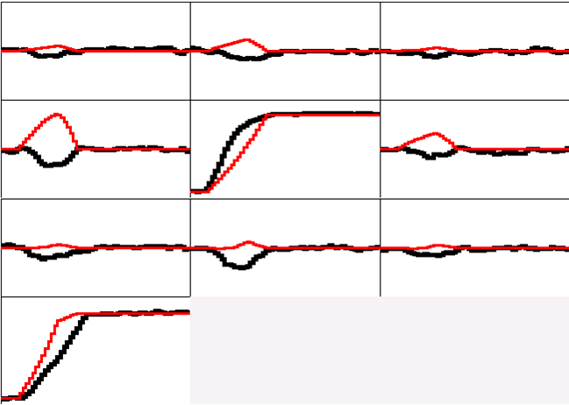
Pulse Shape Analysis concept
A3
A4
A5
B3
B4
B5
(10,15,46)
C3
C4
C5
y
CORE
C4
B4
measured calculated
D4
A4
x
791 keV deposited in segment B4
E4
F4
z = 46 mm

Slide 41
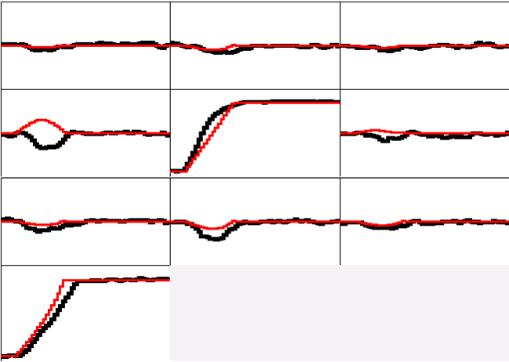
Pulse Shape Analysis concept
A3
A4
A5
B3
B4
B5
(10,20,46)
C3
C4
C5
y
CORE
C4
B4
measured calculated
D4
A4
x
791 keV deposited in segment B4
E4
F4
z = 46 mm

Slide 42
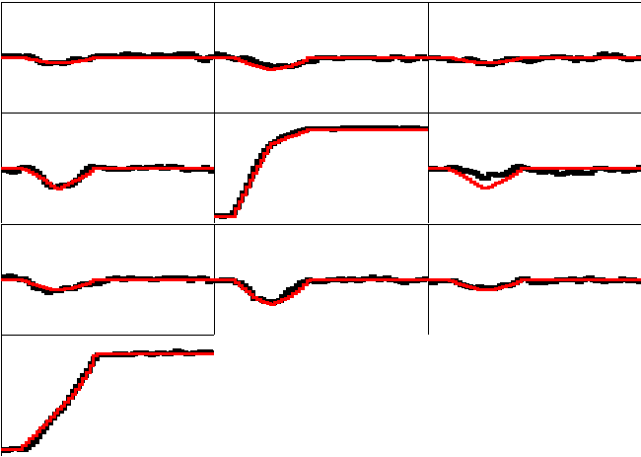
Pulse Shape Analysis concept
A3
A4
A5
B3
B4
B5
(10,25,46)
C3
C4
C5
y
CORE
C4
B4
measured calculated
D4
A4
x
791 keV deposited in segment B4
E4
F4
z = 46 mm

Slide 43
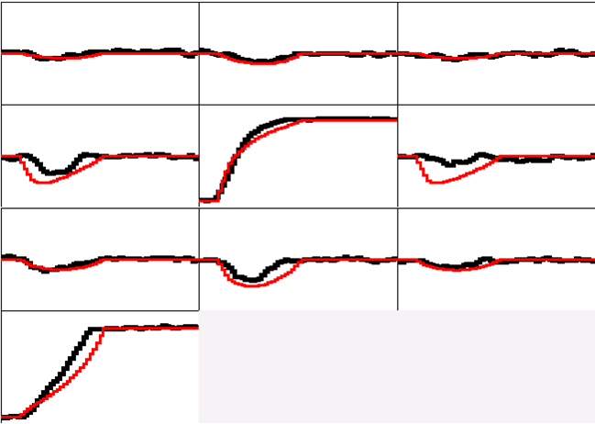
Pulse Shape Analysis concept
A3
A4
A5
B3
B4
B5
(10,30,46)
C3
C4
C5
y
CORE
C4
B4
measured calculated
D4
A4
x
791 keV deposited in segment B4
E4
F4
z = 46 mm

Slide 44
Pulse Shape Analysis concept
A3
A4
A5
Result of Grid Search Algorithm
B3
B4
B5
(10,25,46)
C3
C4
C5
y
CORE
C4
B4
measured calculated
D4
A4
x
791 keV deposited in segment B4
E4
F4
z = 46 mm

Slide 45
The Grid Search algorithm implemented in Narval as PSAFilterGridSearch
Signal decomposition assumes one interaction per segment
The decomposition uses the transients and a differentiated version of the net charge pulse
Proportional and differential cross-talk are included using the xTalk coefficients of the preprocessing.
The minimum energy of the “hit” segments is a parameter in the PreprocessingFilter → 10 keV
No limit to the number of fired segments (i.e. up to 36)
The number of used neighbours is a compile time parameter (usually 2 as Manhattan distance)
The algorithm cycles through the segments in order of decreasing energy; the result of the decomposition is removed from the remaining signal → subtraction method at detector level
Using ADL bases (Bart Bruyneel) with the neutron-damage correction model (the n-damage correction is actually performed in the PostPSAFilter)
Using 2 mm grids → ~48000 grid points in a crystal; 700-2000 points/segments
Speed is ~ 150 events/s/core for the Full Grid Search ~ 1000 events/s/core for the Adaptive Grid Search
To speedup execution, parallelism has been implemented (using boost:threads) with blocks of ~100 events passed to N parallel threads of execution

Slide 46
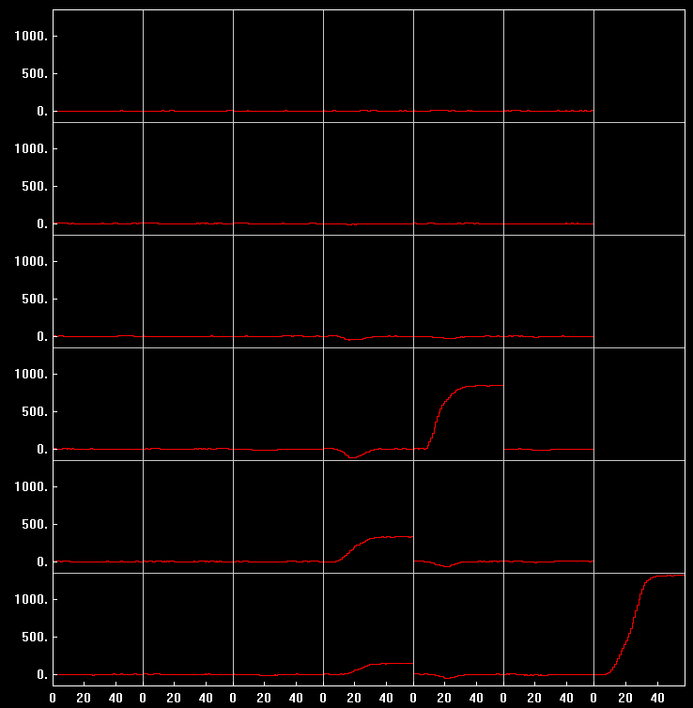
Adaptive Grid Search in action
A B C D E F CC
1 2 3 4 5 6

Slide 47
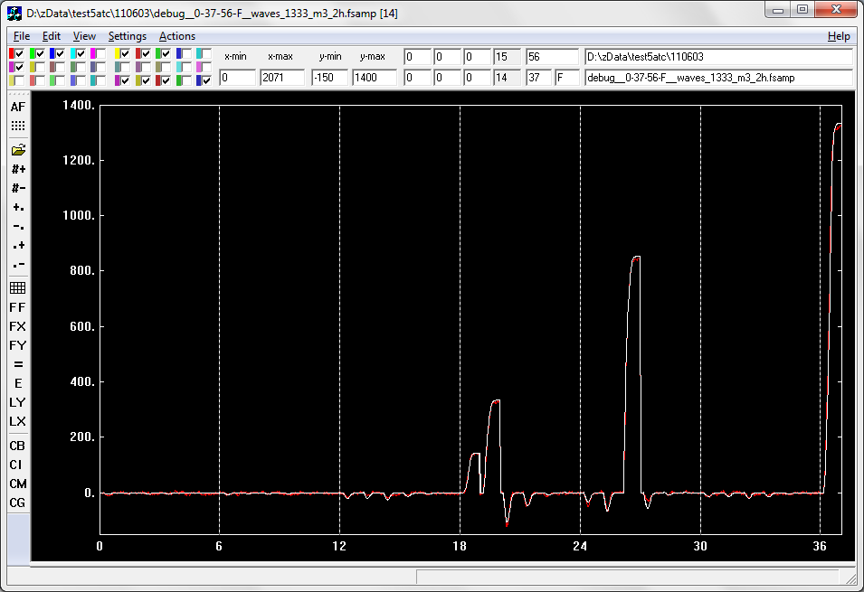
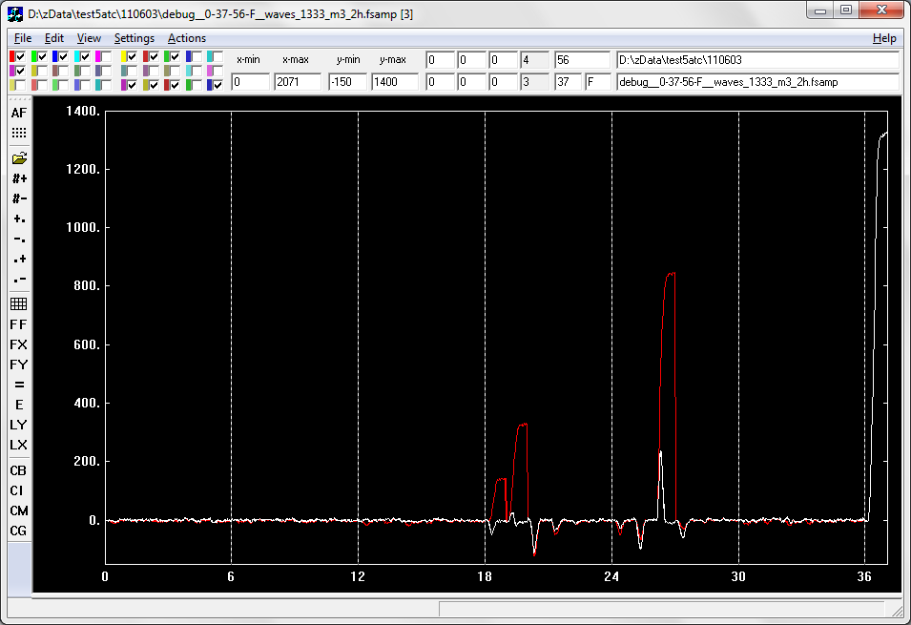
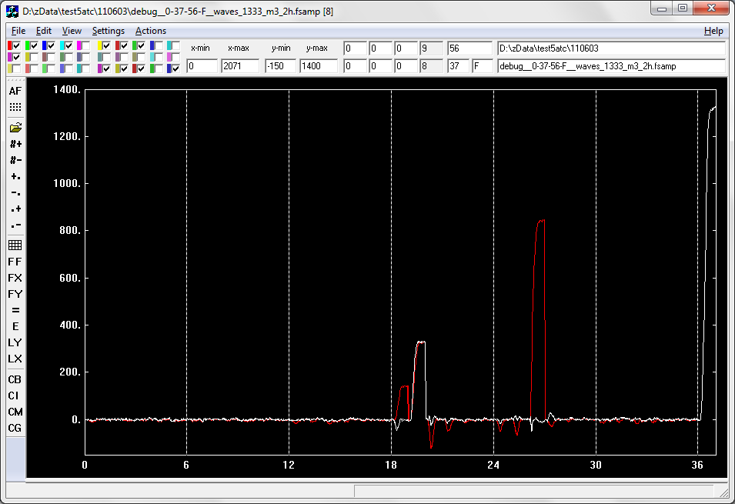
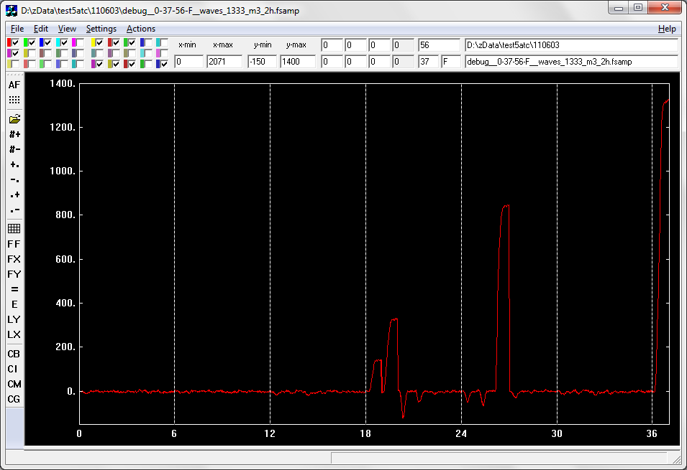

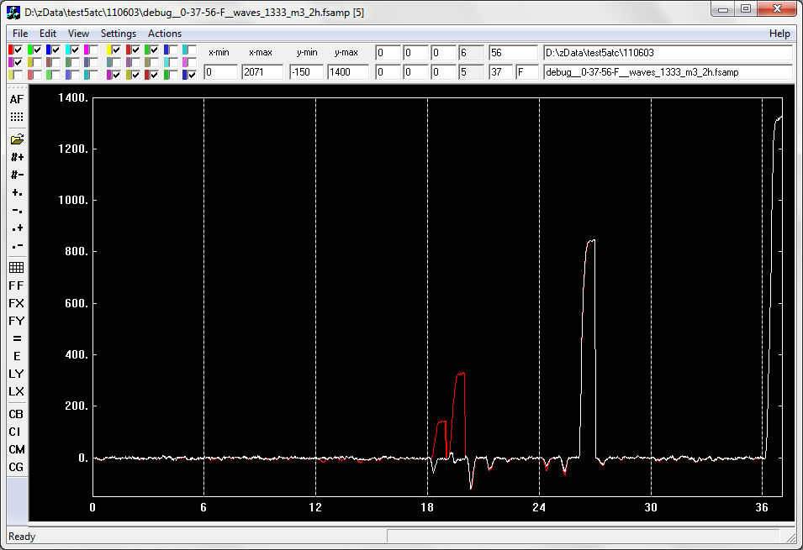

Adaptive Grid Search in action
A B C D E F CC
Event with 3 net-charge segments (D1, D2, E3)
1 Initial residuals, after removing a hit at the center of the net charge segments
2 Largest net-charge segment passed to the search
3 Second net-charge segment searched after removing result of largest one
4 Smallest net-charge segment searched after removing result of the other two
5 Final residuals
6 Final Result

Slide 48
Decomposition with 2 hits/segment
How
Speed
Clearly an improvement for some events
Overall effect on tracking seems rather small
→ H. Lee recent works

Slide 49
Response function and PSA
Fast and slow signals belong to specific parts of segments
If response function not correct signals appear as too fast or too slow, ending up in the corresponding (possibly wrong) regions
Same effect if time alignment not correct (but time is a “free parameter” in PSA)
Parameters
Bandwith of the preamplifier
Fall time of preamplifier (~1% on amplitude)
Fourier transform of “empty” traces

Slide 50
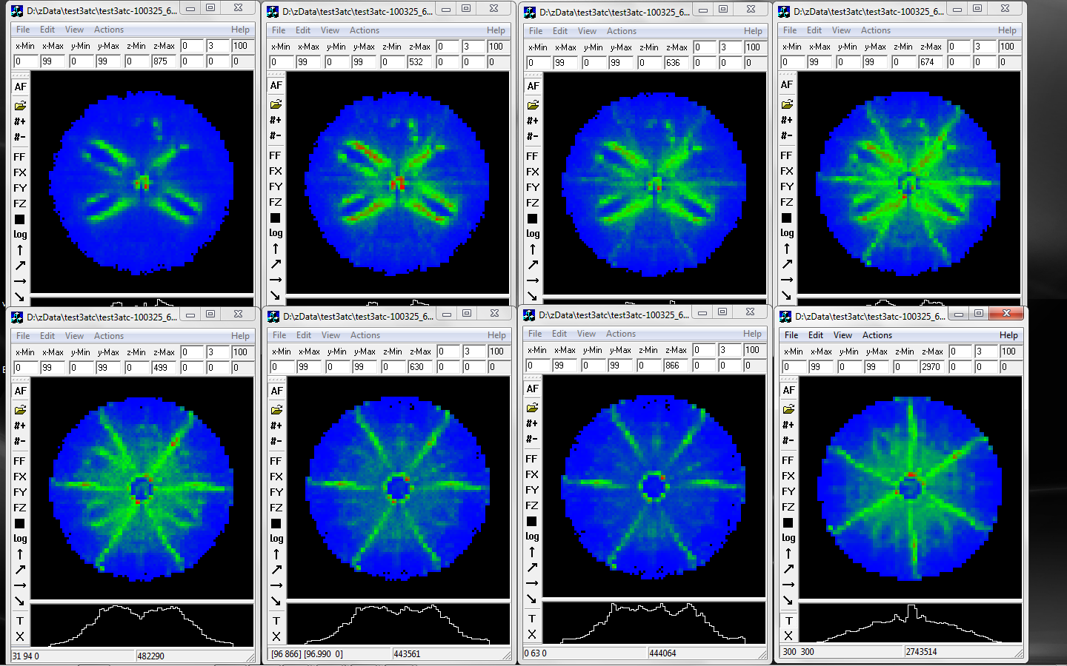
Effect of time alignment
0
5
10
15
20
25
30
22+Tfit
Effect of time position of the experimental trace
Similar behaviour when scanning over the risetime of the preamplifier, because a too-fast/too-slow response sees the experimental traces as slow/fast or late/early

Slide 51
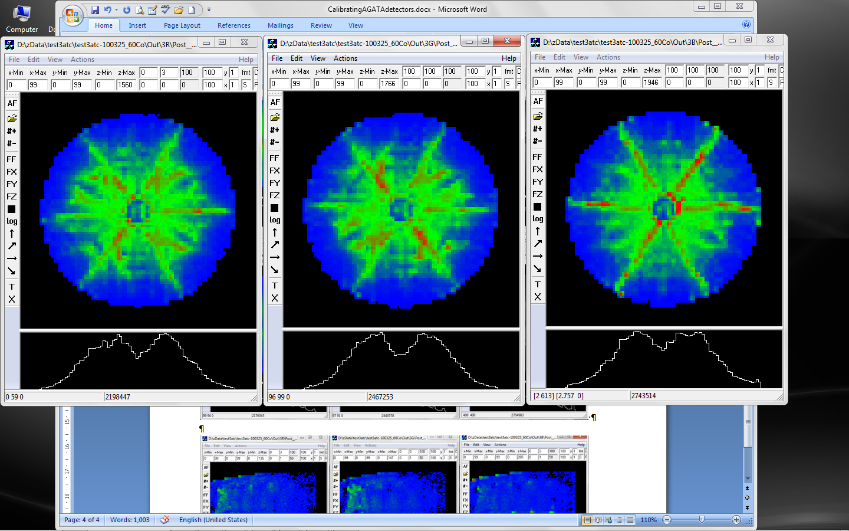
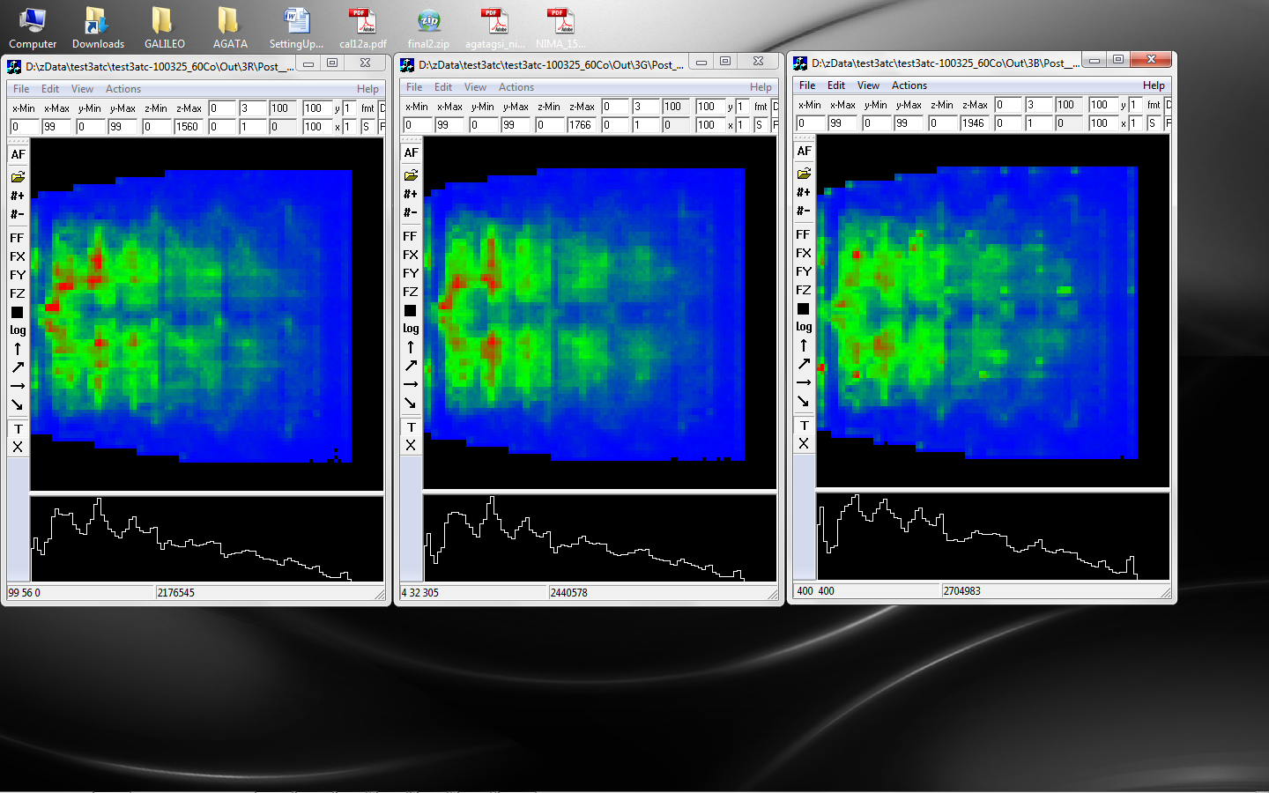
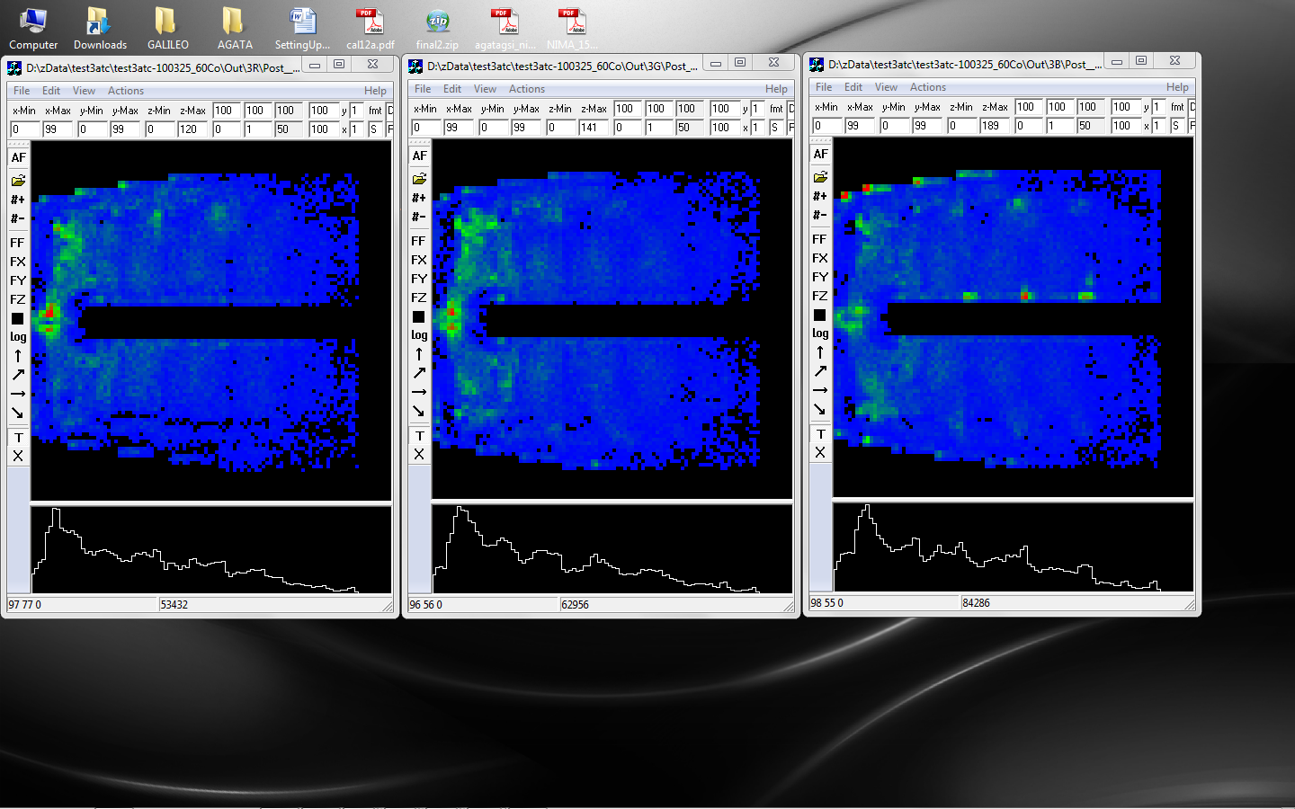
Best time alignment and fit of T₀ of signal
Still a lot of clustering
Difficult to get better results
Is it Problem of:
Algorithm ?
Calculated basis ?
Preparation of data ?
with a different algorithm and a completely different way of preparing the data GRETINA has similar effects
Could be an intrinsic limit of the method

Slide 52
Cross talk and PSA
Logically, cross talk is part of response function of the system
Proportional cross-talk applied to signal basis
Differential cross-talk applied in the same way but clearly not done well. Question of proportionality between the two.
Example

Slide 53
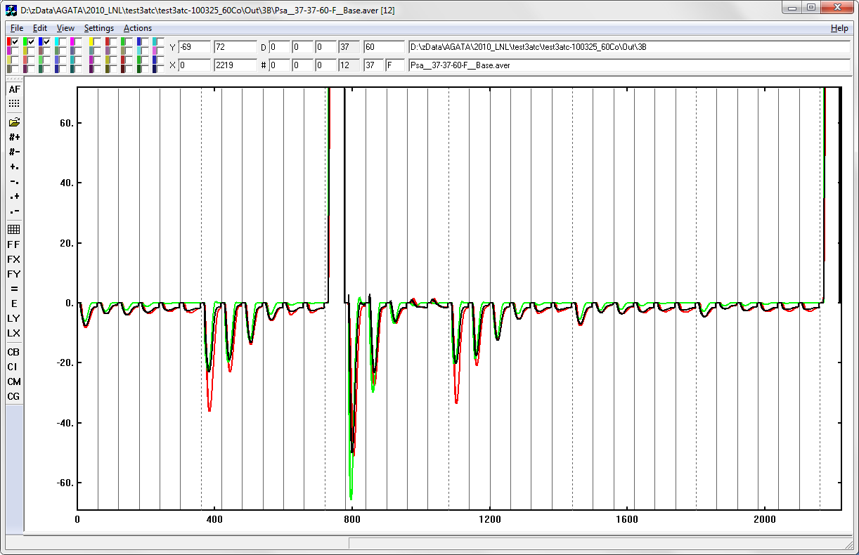
Response function and cross-talk applied to the signal basis
Average over segment C2
Red experimental signal
Green raw basis signals
Black adapted basis
Nearest neighbours particularly bad
Maybe a problem of differential cross-talk

Slide 54
PostPSAFilter
Final energy and time calibrations
Recovery (partial) of neutron damage using info from PSA
Impact of neutron damage on:
energy resolution
Signal shape and PSA
See Damian’s talk

Slide 55
EventBuilder/EventMerger
Work on data filtered by the real-time digital trigger
The software builders use the timestamp of the data coming from the detectors
Could also reconstruct using the eventnumber but this is given with only 24 bits and rolls over every 16M events → modulo electronics
The online Narval builders had a hard life in keeping up with the variability of data flow and sometimes lost synchronization.
A solution was to have very large timeouts in the reconstruction algorithms but this slowed too much down the stop procedures
The latest improvements do not help so much
The offline builders have a simpler life because data flow from files is (?) more smooth (and the timeouts in the reconstruction algorithms can be very large)

Slide 56
TrackingFilter
This is the first point where we can check integrity of global events and analyse them
As AGATA only
Build global spectra: energy, time and T_{γγ}
Adjust gain of CC (and SG, not implemented) → should be moved to postPSA
Force sum energy of segments to energy of CC → small loss of resolution but removes extra left tail
As AGATA + Ancillary
Spectra of Ge in coincidence with ancillary
Gate on T_{Ge}-T_{anc} (still timestamp only) to select the data for tracking
Input of tracking can be written in mgt-style for offline tracking with OFT or MGT
Tacking algorihm
TrackingFilterOFT
Waely’s, parameter-free cluster tracking algo
Output of Tracking written as adf or root tree
Both outputs keep the input hits (and the Ancillary data if present), adding the tracked gammas and the Ancillary filter
Timing is not yet reported properly

Slide 57
Global Actions
Check that all detectors ok
Inspect spectra of cores and segments
Inspect g-g patterns of segments
Global time alignment
Better time windows
In special cases use groups and conditions on groups

Slide 58
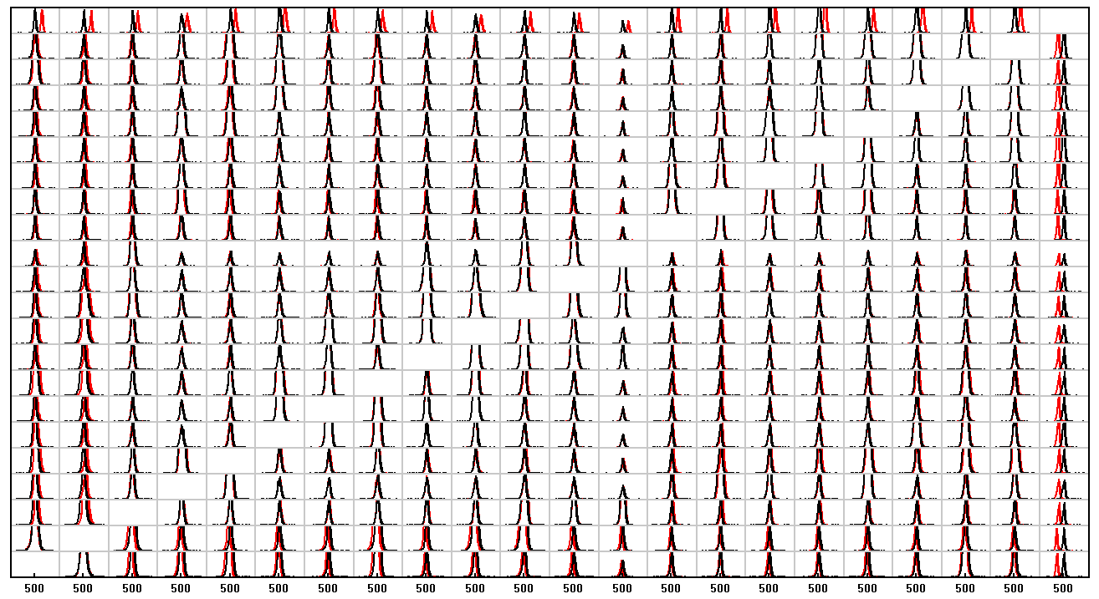
Global time alignment
FTHM of common time spectrum before alignment 44 ns
after alignment 34 ns
(26 ns when gating on EB detector at 1332 keV and full range in the AGATA crystal)

